Slide 1

Computer Vision Neural Network
Notes:
‹#›

Slide 2
Objectives
Understand how to load training data in TensorFlow
Coding a Computer Vision Neural Network
Using Callbacks to control training
Computer Vision Neural Network
‹#›

Slide 3
Dataset
Fashion-MNIST is a dataset of Zalando's article images
Consisting of a training set of 60,000 examples and a test set of 10,000 examples
Each example is a 28x28 grayscale image, associated with a label from 10 classes: 0 T-shirt/top, 1 Trouser, 2 Pullover, 3 Dress, 4 Coat, 5 Sandal, 6 Shirt, 7 Sneaker, 8 Bag, 9 Ankle boot
Original dataset was downloaded from https://github.com/zalandoresearch/fashion-mnist
Computer Vision Neural Network
‹#›
Notes:
‹#›

Slide 4
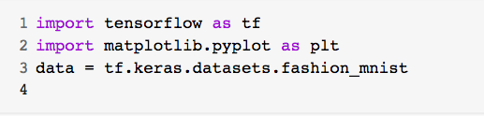
Load training data
Fashion-MNIST is available as a data set with an API call in TensorFlow.
Import dataset:
Split the dataset into Train and Test
Computer Vision Neural Network
‹#›
Notes:
‹#›

Slide 5
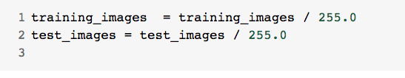
Computer Vision Neural Network
Normalize the pixel values of the train and test images
Change it to between zero and one simply by dividing every value by 255. Why ?
Computer Vision Neural Network
‹#›
Notes:
‹#›

Slide 6
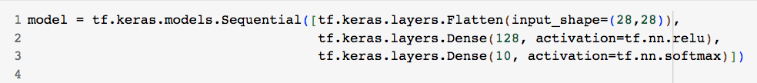
Computer Vision Neural Network
Define Sequential model with 3 layers
Why does the first layer is a flatten layer with the input shaping 28 by 28?
Why does the last layer has 10 neurons?
Computer Vision Neural Network
‹#›
Notes:
‹#›

Slide 7
Computer Vision Neural Network
Define Sequential model with 3 layers
The first layer is a flatten layer with the input shaping 28 by 28.
Flatten takes this 28 by 28 square and turns it into a simple linear array
The last layer has 10 neurons in it because we have ten classes of clothing in the dataset.
Computer Vision Neural Network
‹#›
Notes:
‹#›

Slide 8
Computer Vision Neural Network
Define Sequential model with 3 layers
In middle layer- hidden layer: what is mean of 128?
Computer Vision Neural Network
‹#›
Notes:
‹#›

Slide 9
Computer Vision Neural Network
Define Sequential model with 3 layers
Hidden layer: this is a 128 neurons in it, and I'd like you to think about these as variables in a function
The function was y equals w1 times x1, plus w2 times x2, plus w3 times x3, all the way up to a w128 times x128
Computer Vision Neural Network
‹#›
Notes:
‹#›

Slide 10

Computer Vision Neural Network
Compile the model
Compile the model to finding the loss function and the optimizer, and the goal of these is as before.
→ make a guess as to what the relationship is between the input data and the output data,
→ measure how well or how badly it did using the loss function
Computer Vision Neural Network
‹#›
Notes:
‹#›

Slide 11
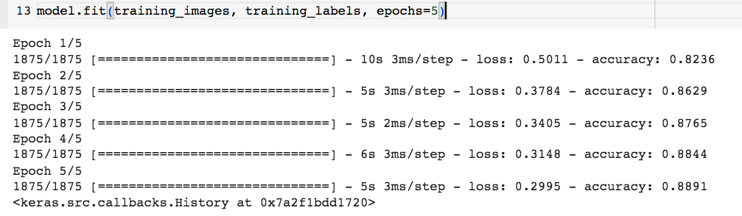
Computer Vision Neural Network
Train model with 5 epochs
Accuracy: 0.8891
Computer Vision Neural Network
‹#›
Notes:
‹#›

Slide 12
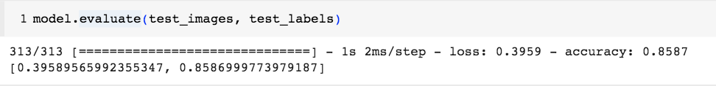
Computer Vision Neural Network
Evaluate the model on unseen data
Train accuracy: 0.8891 and Test accuracy.
→ discuss and give your opinions !
Computer Vision Neural Network
‹#›
Notes:
‹#›

Slide 13
Callbacks to control training
Training with fixed epochs: 5
How can I stop training when I reach a point that I want to be at?
→ in every epoch, you can callback to a code function, having checked the metrics. If they're what you want to say, then you can cancel the training at that point.
Computer Vision Neural Network
‹#›
Notes:
‹#›

Slide 14
Callbacks to control training
In machine learning, a callback is a set of functions that are applied at given stages of the training process.
These functions can be used to perform various tasks such as logging information, saving model checkpoints, adjusting learning rates, or stopping training early based on certain conditions.
Callbacks are a powerful tool for customizing and extending the behavior of a training process.
Computer Vision Neural Network
‹#›
Notes:
‹#›

Slide 15
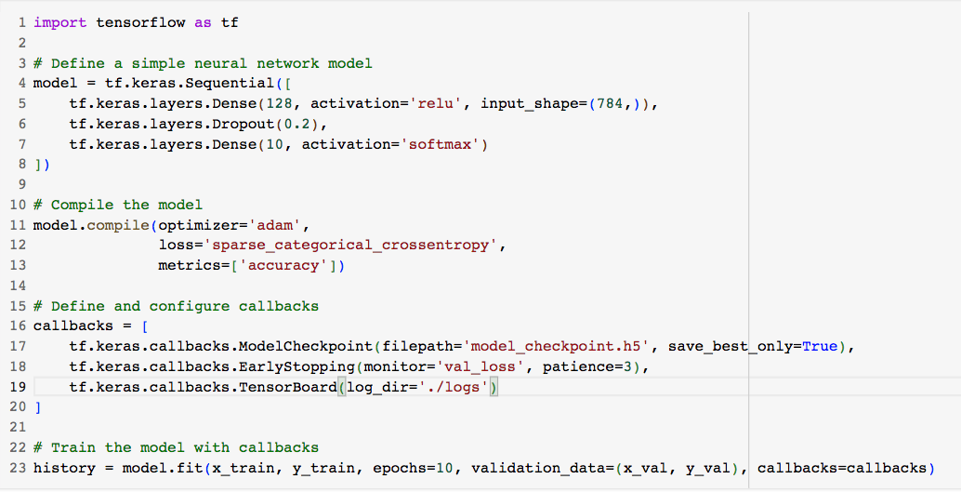
Callbacks to control training
Computer Vision Neural Network
‹#›
Notes:
‹#›

Slide 16
Callbacks types
ModelCheckpoint:
This callback saves the model weights to a file ( 'model_checkpoint.h5') whenever the validation loss improves. This is useful for later loading the best model.
EarlyStopping:
This callback monitors the validation loss and stops training if the loss does not improve after a certain number of epochs (specified by the patience parameter).
TensorBoard:
This callback logs training and validation metrics for visualization in TensorBoard, a web-based tool provided by TensorFlow.
Computer Vision Neural Network
‹#›
Notes:
‹#›

Slide 17
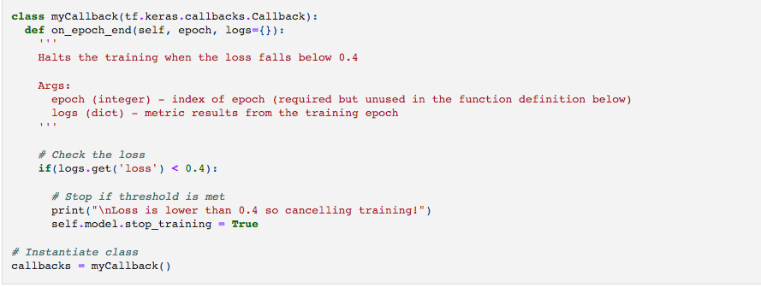

Callbacks to control training
Stop training when loss < 0.4
Computer Vision Neural Network
‹#›
Notes:
‹#›

Slide 18
Summary
Understand how to load training data in TensorFlow
Coding a Computer Vision Neural Network
Using Callbacks to control training
Computer Vision Neural Network
‹#›

Slide 19
Q & A
Computer Vision Neural Network
‹#›

